Slide 1
Attributes in Inventor
Presenter
Developer Technical Services

Slide 2
Agenda
Attributes – Definition
Attributes – Common use
Creating Attributes
Querying Attributes
Purging Attributes
Examples
Additional Functionalities

Slide 3
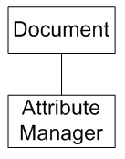
Attributes
Attributes allow the programmer to attach non graphical data on most of Inventor objects (even Document) in the form of named data or a name-value pair.
There is NO direct User Interface equivalent to Attributes.
The AttributeManager provides different methods of querying for entities and/or attributes based on the associated attribute information.

Slide 4
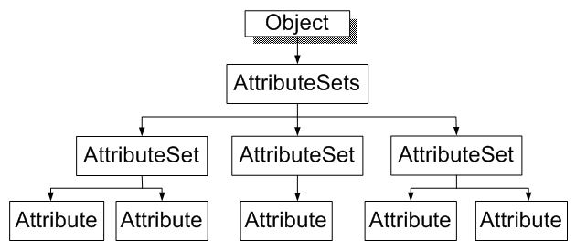
Attributes – Common use
Common use of attributes is to attach an attribute in order to find the entity later (entity naming).
Attributes allow you to add information to any entity and query for that information at a later time.
You can also use attributes to attach specific data to entities that will be used by your custom application.

Slide 5
Creating Attributes
Attributes are supported by all objects that expose the AttributeSets property.
Each object can have multiple attribute sets.
Each attribute set must have a unique name with respect to other attributes sets on that entity.
Each attribute set can contain any number of attributes.
Each attribute must have a unique name with respect to other attributes in that set.
MyAttributes
Load = 400
DirectionX = 0
DirectionY = 0
DirectionZ = 1

Slide 6
Creating AttributeSet and Attributes
From AttributeSets Collection add a new AttributeSet :
Public Function Add( ByVal AttributeSetName As String,
Optional ByVal CopyWithOwner As Boolean = False )
As AttributeSet
From AttributeSet Collection add a new Attribute:
Public Function Add( ByVal AttributeName As String,
ByVal ValueType As ValueTypeEnum,
ByVal Value As Variant ) As Attribute
ValueTypeEnum: kIntegerType
kDoubleType
kStringType
kByteArrayType
kBooleanType

Slide 7
Querying Attributes
AttributeManager supports different methods to query for attributes.
Can query based on attribute set name, attribute name, and/or attribute value.
FindAttributes
FindAttributeSets
FindObjects
Public Function FindObjects(
Optional ByVal AttributeSetName As String = "*",
Optional ByVal AttributeName As String = "*",
Optional ByVal AttributeValue As Variant ) As ObjectCollection
Notes:
Wildcard characters are legal when used to specify AttributeSet or Attribute names. So, it is possible to perform searches for objects using partial name or value strings.
OpenAttributeSets provides optimized method of adding attributes to many entities.

Slide 8
Querying Attributes - Performances
Inventor builds a cache of object-to-AttributeSet links as these links are referenced. This cache greatly reduces access time for subsequent references.
You can force Inventor to build the entire cache, for all objects, by calling the FindObjects method with no arguments. Then perform your query:
When working with large numbers of Attributes, enclose your Attribute editing in a Transaction or ChangeProcessor. This tells Inventor not to use its own automatic transaction and undo mechanism, greatly improving performance.

Slide 9
Purging Attributes
Attributes remain in the file even if the associated entity no longer exists. This is because the entity can sometimes come back into existence.
The AttributeManager.PurgeAttributeSets method can be used to delete a set of specified attributes whose entity no longer exists.

Slide 10
Creating Attributes - Example
Public Sub AddAttribute()
' Get the selected edge. This assumes an edge is already selected.
Dim oEdge As Edge
oEdge = _InvApplication.ActiveDocument.SelectSet.Item(1)
' Add an attribute set to the edge. If you only need to "name" the
' edge this is enough to find it later and you can skip the next step.
Dim oAttribSet As AttributeSet
oAttribSet = oEdge.AttributeSets.Add("BoltEdge")
' Add an attribute to the set. This can be any information you
' want to associate with the edge.
Call oAttribSet.Add("BoltRadius", ValueTypeEnum.kDoubleType, 0.5)
End Sub

Slide 11
Querying Attributes Example
Public Sub QueryAttribute()
' Set a reference to the attribute manager of the active document.
Dim oAttribMgr As AttributeManager
oAttribMgr = _InvApplication.ActiveDocument.AttributeManager
' Get the objects with a particular attribute attached.
Dim oObjs As ObjectCollection
oObjs = oAttribMgr.FindObjects("BoltEdge", "BoltRadius", 0.5)
' Get the objects that have an attribute set of a certain name.
oObjs = oAttribMgr.FindObjects("BoltEdge")
' Get the attribute sets with a certain name.
Dim oAttribSets As AttributeSetsEnumerator
oAttribSets = oAttribMgr.FindAttributeSets("BoltEdge")
' Get the attribute sets with a certain name using a wild card.
oAttribSets = oAttribMgr.FindAttributeSets("Bolt*")
End Sub
Notes:
Query Attribute: this assumes a part document with some features is opened and you have run AddAttribute (in slide 10) on an edge

Slide 12
Additional Functionalities
The AttributeSets object also supports the DataIO object, allowing attribute data to be written out in XML form.
Attributes and AttributeSets also support the Transient property. If this property is set to true, or if the AttributeSet is created using the AddTransient method of AttributeSets, the attribute data is not persisted beyond the current session. This is useful if you want to do some short-term data manipulation but do not wish to 'dirty' the document.

Slide 13

Notes:
Thank you!
Questions?

